Slide 1
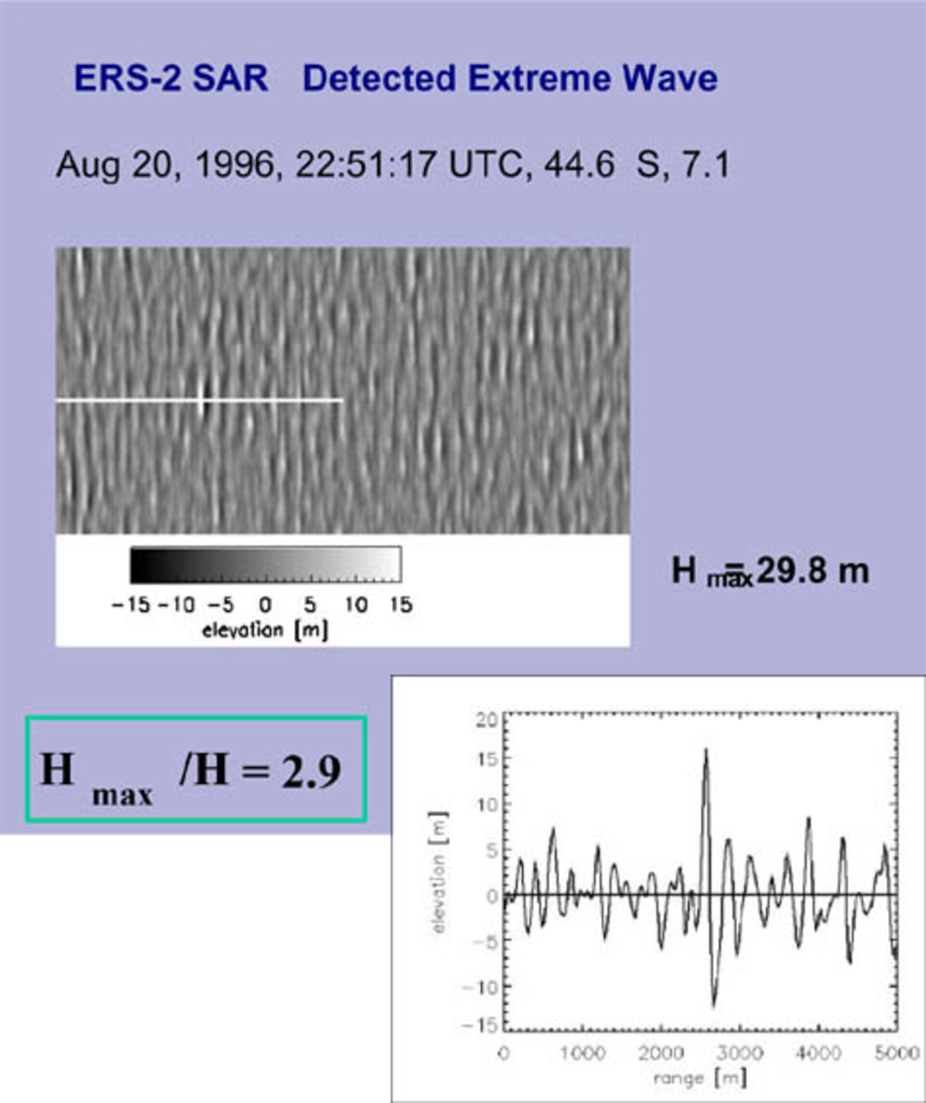
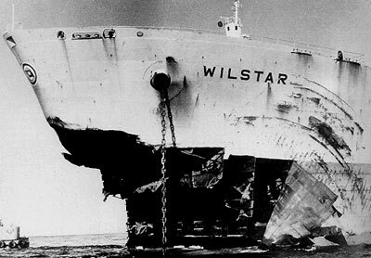
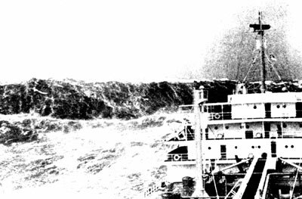
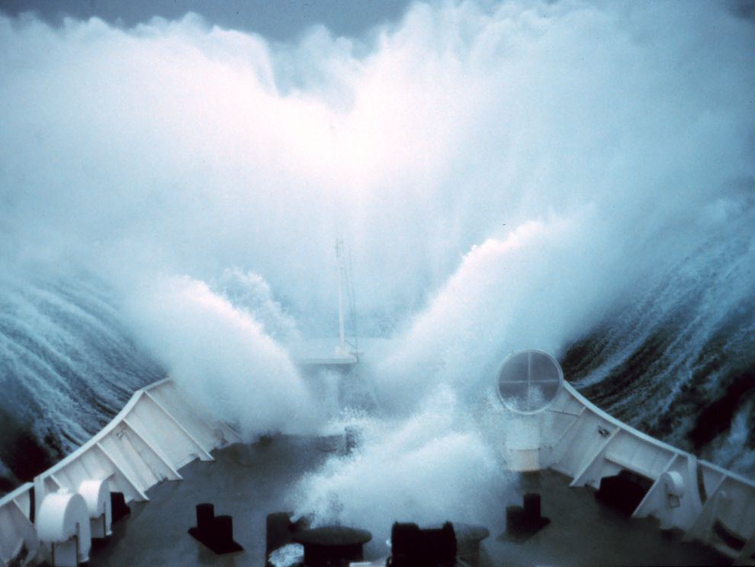


In Early 2001 the ERS satellites, part of the MaxWave study funded by the European Space Agency, surveyed a stretch of the Southern Atlantic ocean for three weeks. During that short time span, imagettes from the satellites captured 10 separate instances of rogue waves more than 25m in height. One or two of which struck the cruise liners Bremen and Caledonian Star. To the left, is an example of one such imagette showing a characteristic rogue wave of almost 30m in height along with the recorded wave spectrum.
https://www.esa.int/Applications/Observing_the_Earth/Ship-sinking_monster_waves_revealed_by_ESA_satellites
Rogue Waves or Freak Waves are waves that are larger than statistically expected for a given sea state. They can be extremely tall and are caused by the constructive interference of multiple different waves. They can be determined by the relationships:
$$\frac{H_{max}}{H_{s}}>2$$
$$\frac{C_{max}}{H_{s}}>1.25$$
Where H_{max} is the zero-cross wave height, C_{max} is the crest height, and H_{s} is the significant wave height (estimated by the top 1/3 percentile of wave heights)
Cattrell, A. D., Srokosz, M., Moat, B. I., & Marsh, R. (2018). Can rogue waves be predicted using characteristic wave parameters? Journal of Geophysical Research: Oceans, 123, 5624– 5636. https://doi.org/10.1029/2018JC013958
On January 1, 1995, a massive 21m rogue wave struck the oil platform Draupner in what was the first digitally-recorded instance of a freak wave.
Rogue waves commonly occur off the southeast cost of South Africa; it is theorized that they are so common because a large ocean swell hits the Agulhas current. The current acts a focusing lens, reducing the wavelength and therefore increasing wave steepness and height into a rogue wave.
Initially scientists and methematicians believed such 20m rogue waves could only occur once every tens of thousands of years. It wasn’t until the late 1990’s when experiments and observations showed the real numbers were far more common than expected.
Source
Source
Source

